Slide 1
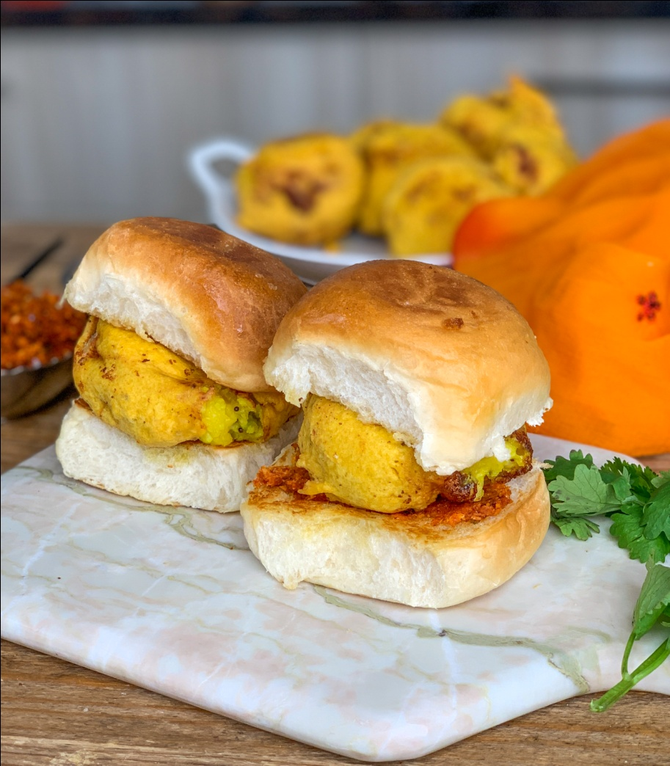
CASE STUDY – WADA PAV (A study for the new wada pav shop in the shivaji nagar, pune )
PRESENTED BY – SANA TAHASILDAR

Slide 2
Agenda
Introduction
Problem Statement
Objective & Methodology
Solution Description
Business Impact

Slide 3
Introduction
The dish is believed to have been invented in 1966 by a Mumbaikar, Ashok Vaidya, who opened the first vada pav stall opposite the Dadar train station, through which hundreds of thousands of workers – often in need of a quick, inexpensive snack passed every day on their way to the textile mills in suburbs such as Parel and Worli. Vada pav was an instant hit with Bombayites (as Mumbaikars were then known). Vaidya remains a Mumbai icon; one local journalist even made a documentary about him, called Vada Pav Inc.

Slide 4
Problem statement A man wants to open a wada pav shop near shivaji nagar in pune. He has got location where there are other 4 wada pav shops. He is not able to understand what will be the stratergy to take over his clients.
Starting a Vada pav outlet does not involve much investment
The government licensing fee is also very nominal. The raw materials are easily available.
The switching cost, in case the business does not perform well, is also very small
. Vada pav has been associated with Mumbai and tourists want to taste the Mumbai Vada pav.
KVP has launched different varieties of Vada pav, which has prompted even the locals to try the new addition
Outlets have been opened at places that are usually thronged by locals and tourists

Slide 5
Objective & Methodology
Understanding the supply and demands from local people which is not fulfilledby other competitors and making a solid business strategy to get more sales
✓ Identifying the route map for steady growth in future

Slide 6
1. Pricing

Slide 7
2.Differenciation
Delivery
Online delivery
Zomato
Swingy
Food panda
Quick service quality
Payment mode
Cash
BHIM
UPI
G-PAY
Phone Pay
Services & Amenities
Outdoor Seating
Home Delivery
Serves Non Veg & Veg
Parking Available
e-Wallets Accepted
Social media platform
Instagram
Facebook
What's app order &
Just dial
Food blogs
WordPress
Affordable price with different types of combo
High hygiene with verity of offering
Strong branding and local market deep knowledge

Slide 8
TOP 5 WADA PAV SHOP IN SHIVAJI NAGAR PUNE (IN 5KM AREA)
NAME | MOBILE NO | RATING (*)/5 | TIME | AMBIENCE | SERVICE | FOOD | VALUE OF MONEY
GOLI WADA PAV | 9921054090 | 3.6 | 9.00am to 10.00 pm | 3.6 | 3.6 | 3.6 | 3.7
JOMBOKING (AHARDUL EXPRESS) | 8007759820 | 4.6 | 9.00am to 10.30 pm | 4.5 | 4.7 | 4.5 | 4.7
JOSHI WADEWALE | 8805124996 | 3.6 | 7.00am to 10.00 pm | 3.6 | 3.5 | 3.5 | 3.7
THE WADA PAV CAFE | 7345682901 | 4 | 11.00am to 10.00 pm | 4 | 4.1 | 3.9 | 4.1
ROHIT WADEWALA | 8071268307 | 3.5 | 9.00am to 10.00 pm | 3.5 | 3.4 | 3.6 | 3.6

Slide 9
3.Competitor’s Analysis
JOSHI WADEWALA
SWOT Analysis
Strengths
Strong Market Position
Innovative Concept.
Strong business models
Large Customer base and Geographical Outreach
Weaknesses
Lack of Financial and Technical resources
Devaluation of Mexican Currency
Lack of expertise in operating in U.S markets
Opportunities
Increase demand of theme parks
High Internet penetration
Increased mobile phone usage
Threats
Currency devaluation
Intense domestic and international competition

Slide 10
4.Positioning
A good quality product with different verity
Standard row material and fresh food for customers
Middle and low income group people
Mainly Student, couples, employees
Clean and hygienic branded Vada-pav
Low price with best quality compare to others
Best Services & Amenities compare to others

Slide 11

Thank you .....

